Slide 1

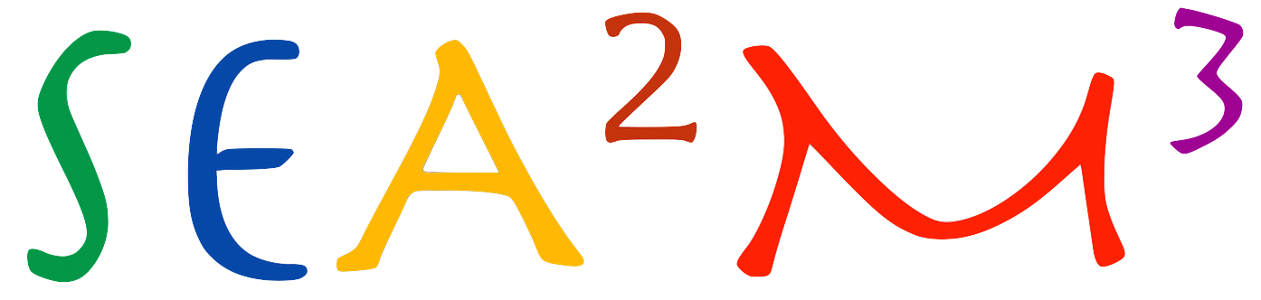
EID-101A
RAMESSES II
Notes:
Font: Georgia
Change the background to RAMESSES II

Slide 2
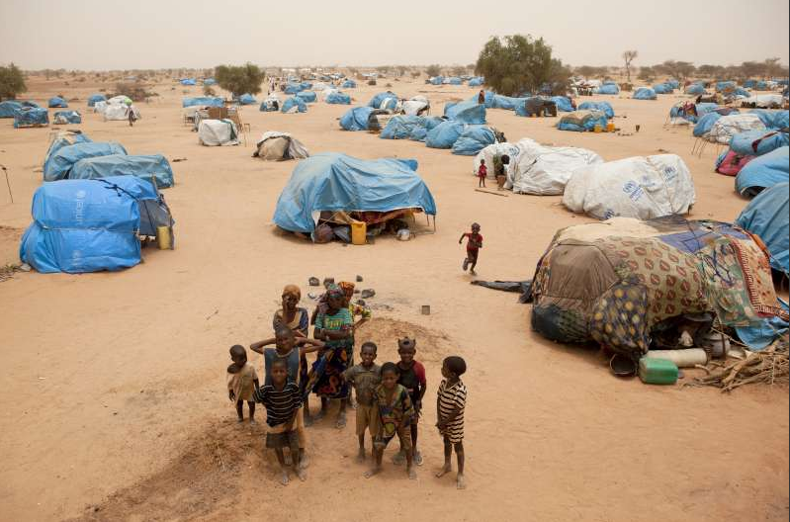

Slide 3
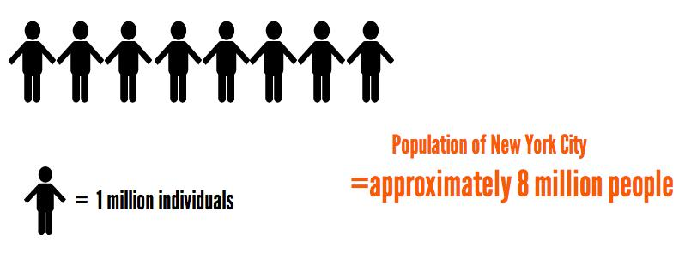
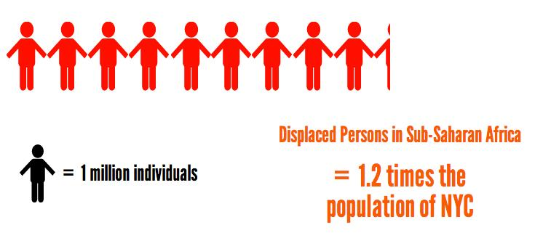
10 million?
Notes:
10 million is the number of individuals in SSA who do not have a place to call home. 10 million is the number of individuals who were forced to evacuate their homes in search for a refuge from natural disaster, political turmoil, economic crises, and cultural conflicts. 10 million is the number of individuals we are trying to reach out to help.
Say that there are about 8 million ppl in NYC, and the number of SSA refugees is 1.2 times the population of NYC

Slide 4
Problem Statement
Create a safe and durable emergency shelter kit for refugees and internally displaced persons in Sub-Saharan Africa
Notes:
Make sure people know about what is the difference between refugees and IDPs and what IDPs stands for
Biodegradable
Local Materials

Slide 5
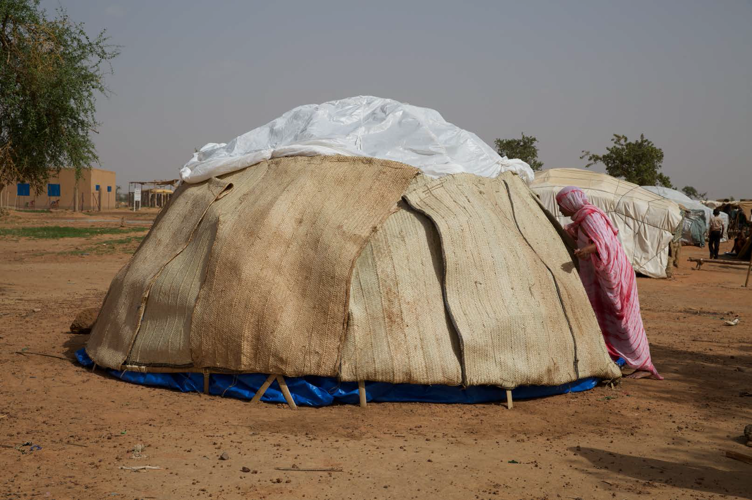
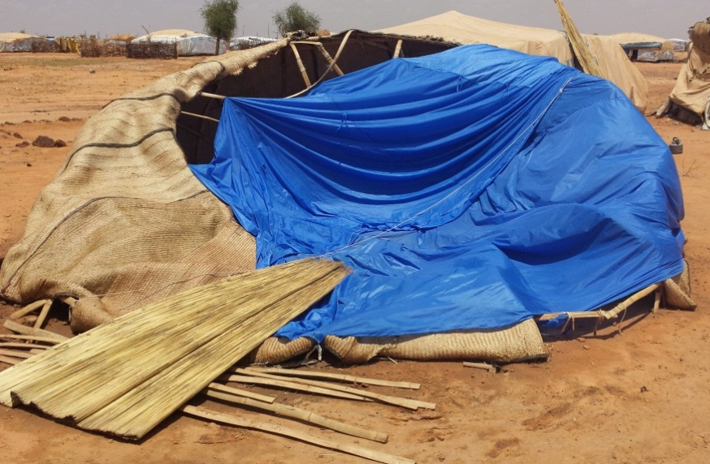
RAMESSES I
Notes:
Overview
They tried to solve it
what problems were found / failures
picture of final ramesses I

Slide 6
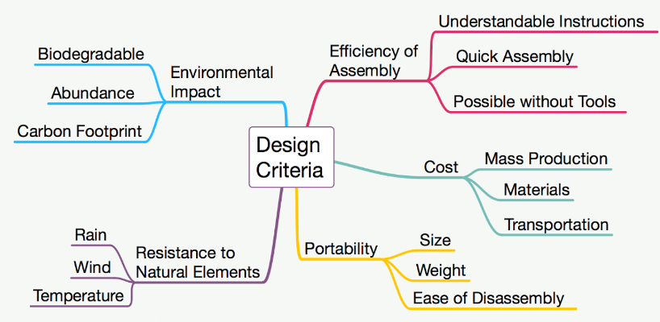
Design Goals
Notes:
Resistance to elements (rain/wind) but also better breathability

Slide 7
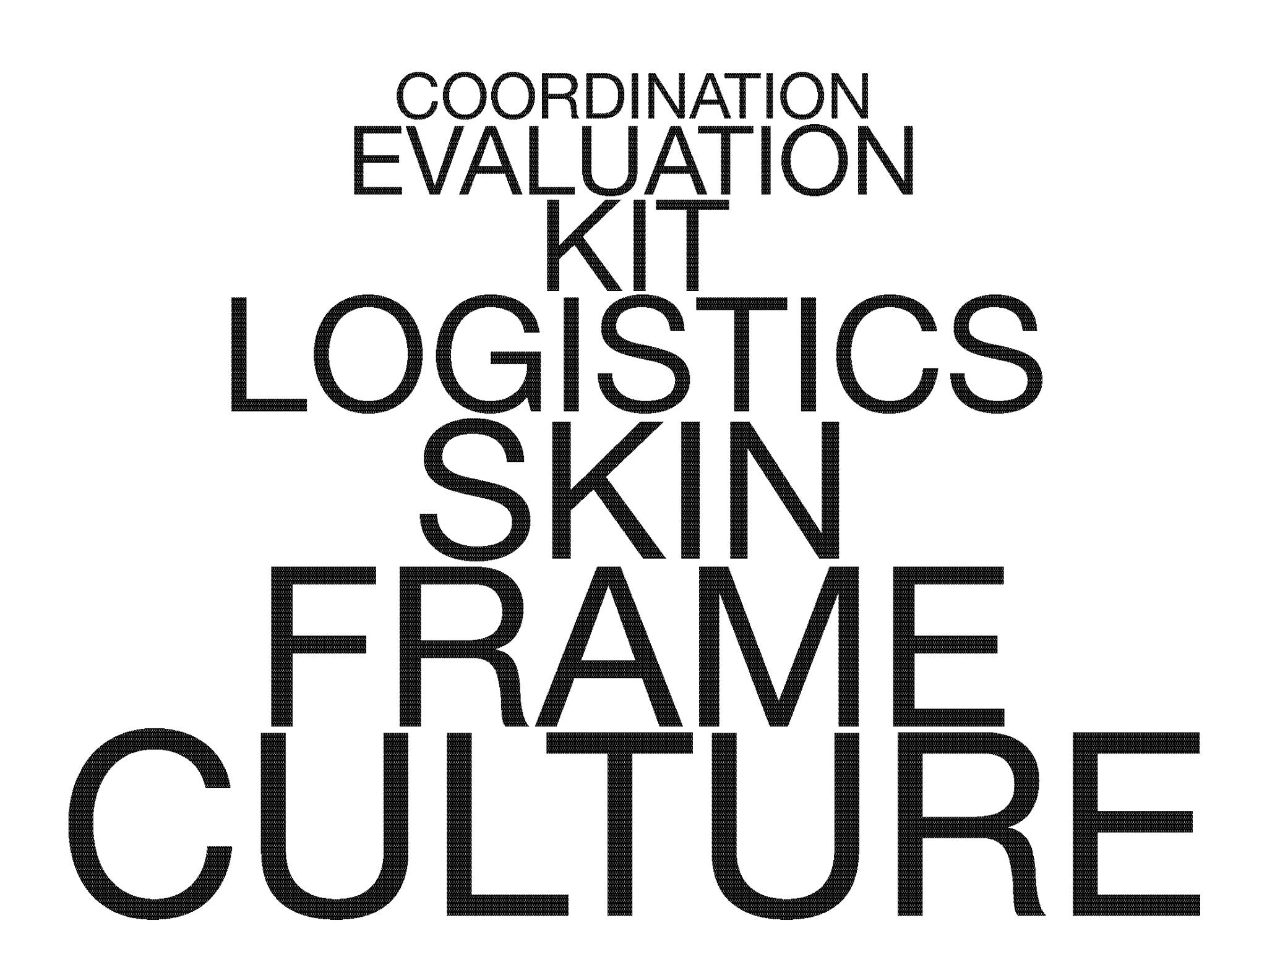
Group subdivision
Notes:
Explain why the font sizes are different -- order of imp

Slide 8
Frame
Mission Statement:
Create a stable frame for RAMESSES II that is easy to assemble
Notes:
evuation join the talking
Mission statement maybe?

Slide 9
Folding Fan

Slide 10
Basic Dome

Slide 11
Truss Design

Slide 12
Hexagonal Gumdrop

Slide 13
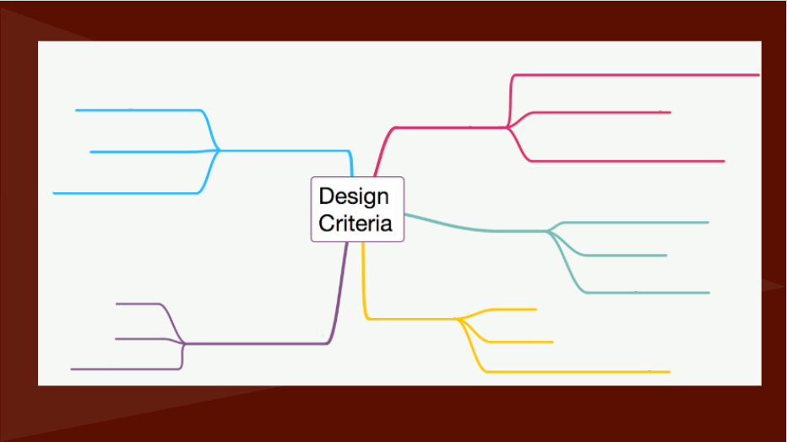
Understandable Instructions
Biodegradable
Efficiency of Assembly
Quick Assembly
Environmental Impact
Abundance
Possible without Tools
Carbon Footprint
Cost
Mass Production
Materials
Resistance to
Natural Elements
Packageable
Rain
Size
Portability
Wind
Sturdiness
Weight of kit
Temperature
Ease of assembly

Slide 14
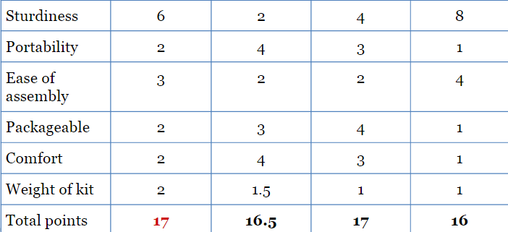
Hex Gumdrop Folding Fan Basic Dome Truss
Notes:
DO NOT DELETE

Slide 15
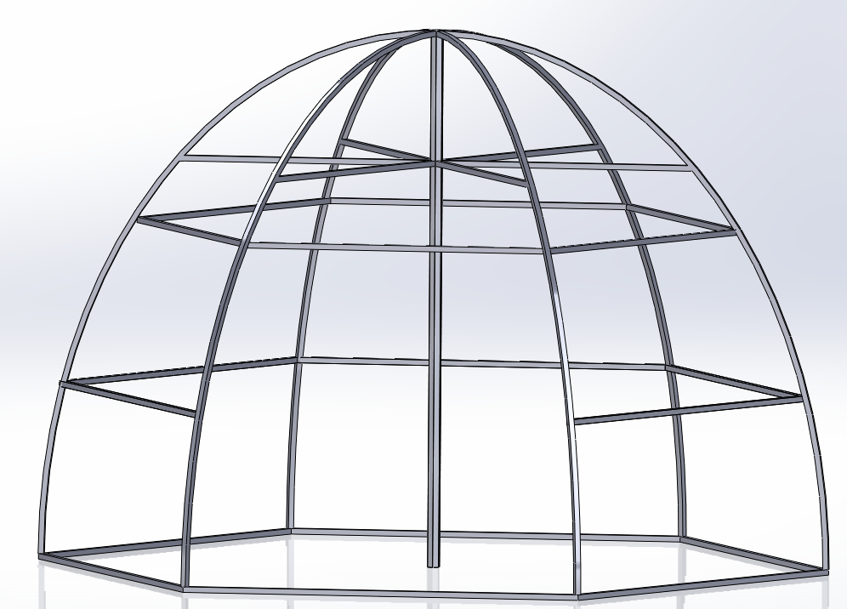
Notes:
SAY THIS DURING PRESENTATION PLS~
>>>>
Why did we have a hexagonal base:
-Previous design was a full circular base but our design allows us to have more sides for deflection of wind and it allows us to put in the arches at the vertices rather than random or equally spaced out places in a circle. It makes the assembly process easier because ideally this base can be a standalone without having to be buried into the ground due to us using full and half tubes of bamboo.
-Having full tubing for 3 edges of the hexagonal gumdrop allows us to just drill a hole into it and use it as a place holder for our quarter piece bamboo arches.
-The hexagonal base is visually appealing and allows us to still have a good amount of surface area that is usable compared to the circular base.

Slide 16
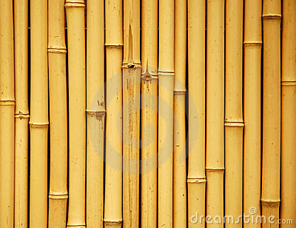
Why Bamboo?
Pros:
Abundant in Sub-Saharan Africa
Light-weight
Sturdy
Cons:
Splits in dry climate

Slide 17
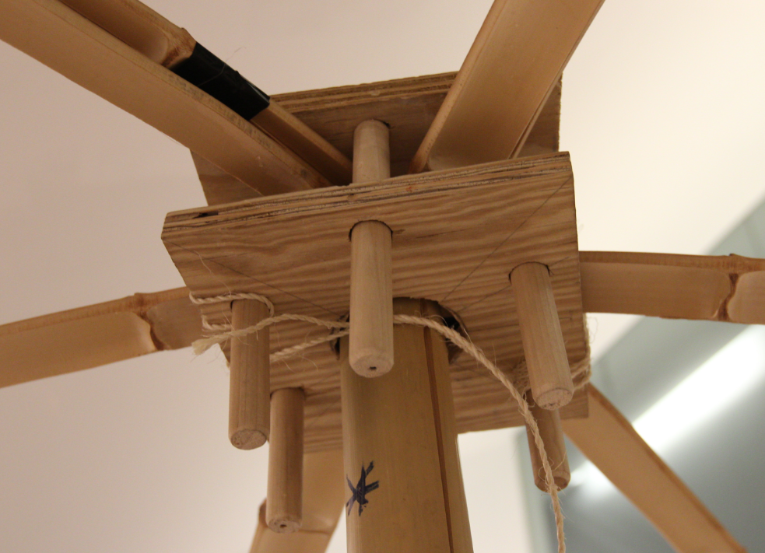
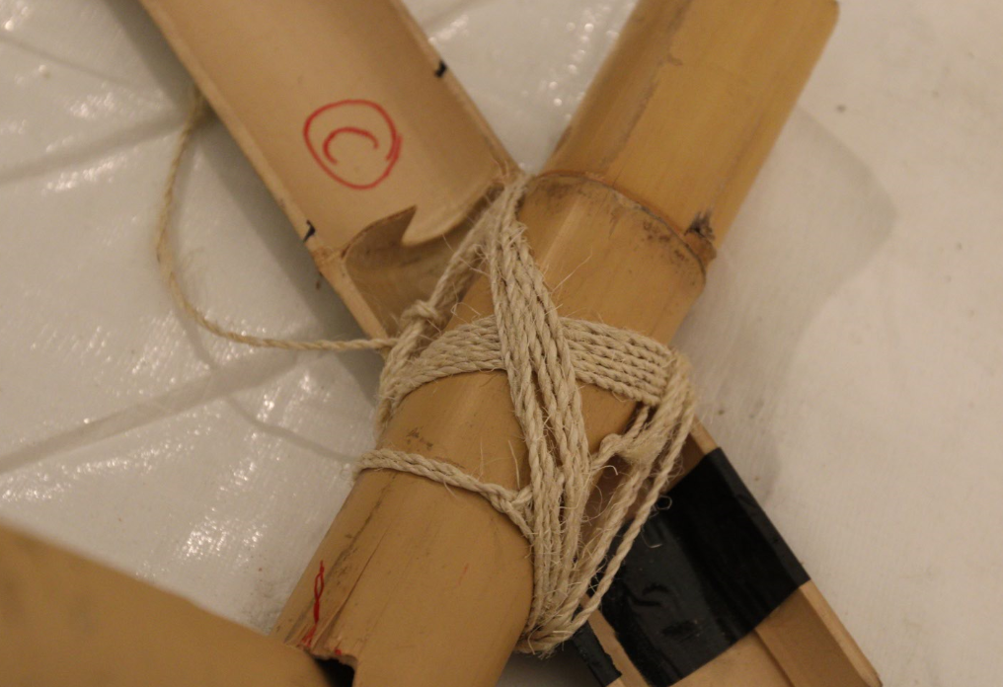
Notes:
?? why are these slides first when talking about the frame??

Slide 18
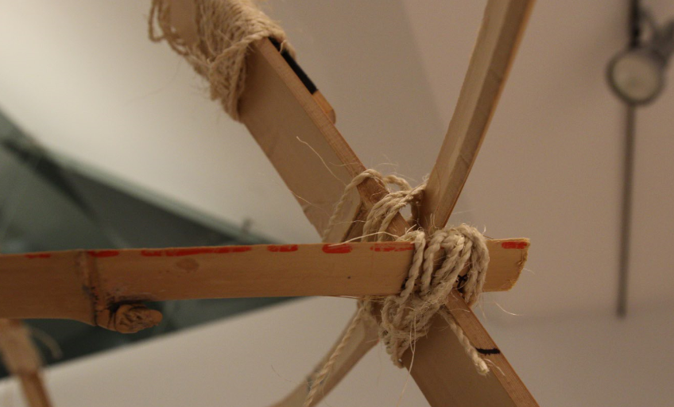
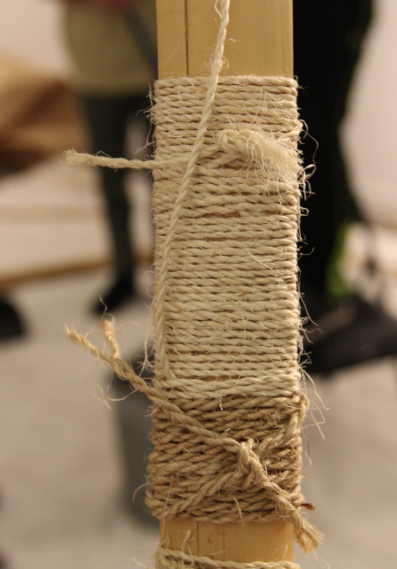

Slide 19
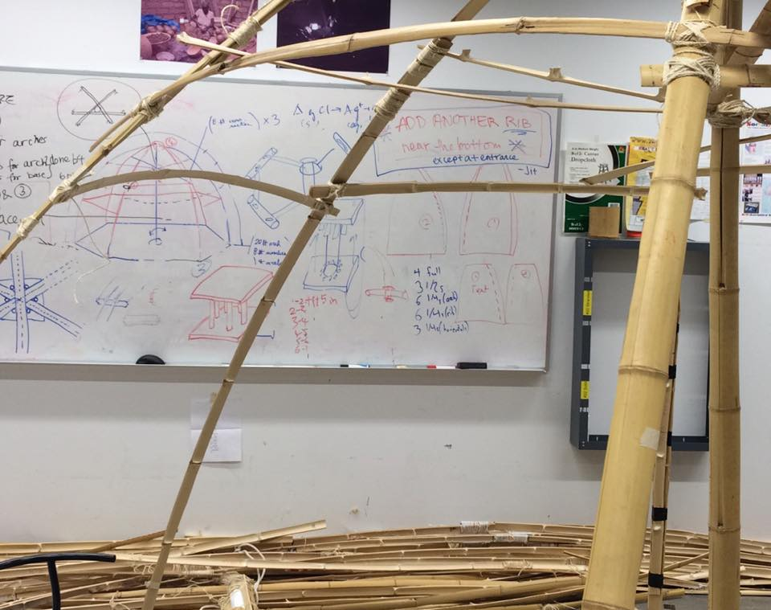
Frame Evaluation

Slide 20
Skin
Notes:
The purpose of the skin is to create a barrier between the interior of the shelter and the surrounding environment. Overall, the skin has to satisfy specific criteria in order to be effective.
The skin of the shelter is broken down into three different layers; each one provides a different benefit to the shelter and work together to meet all of our design goals.

Slide 21
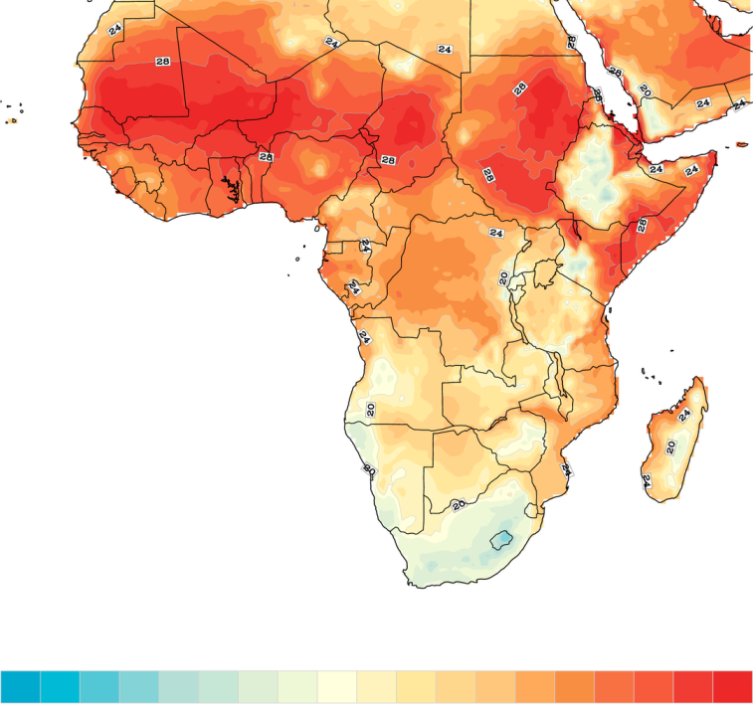
Temperature in Africa 2013
Mean Temperature in Africa
40 degrees Celsius
41F
-20 degrees Celsius
86F
Notes:
draw line to represent subsaharan africa and change title..

Slide 22
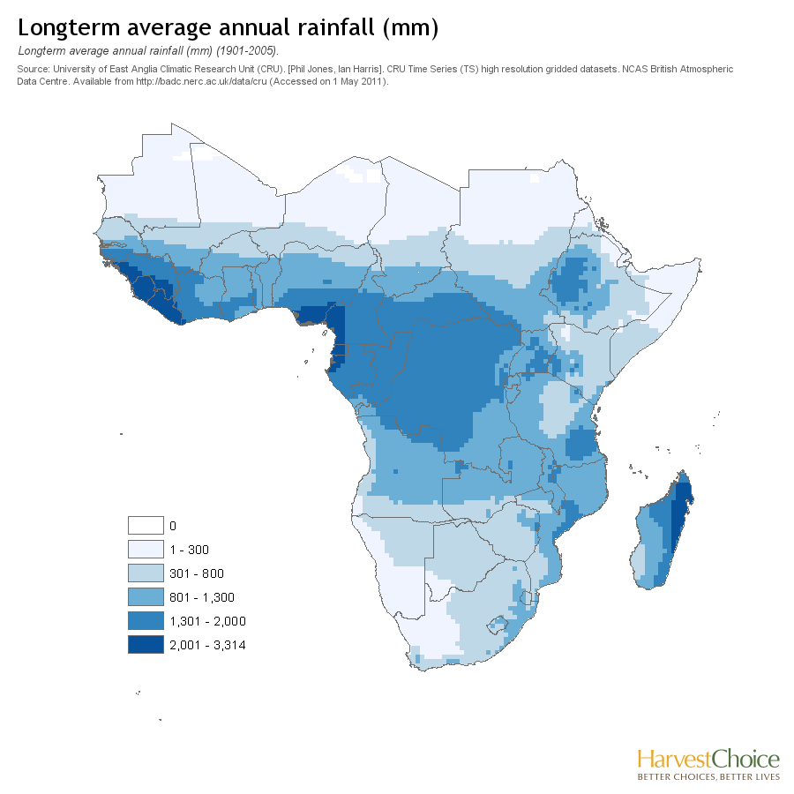
Annual Rainfall in Sub-Saharan Africa (mm)

Slide 23
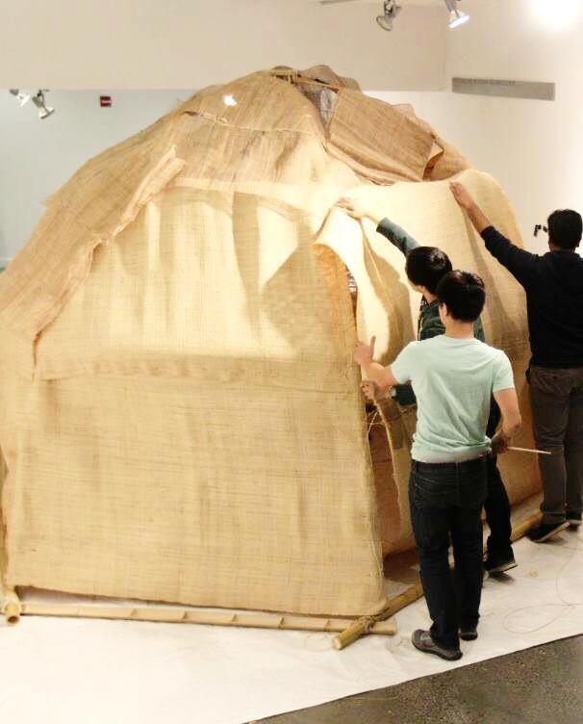
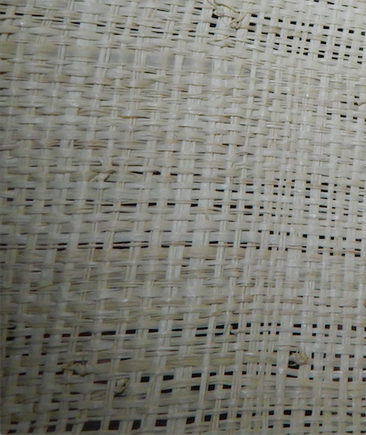
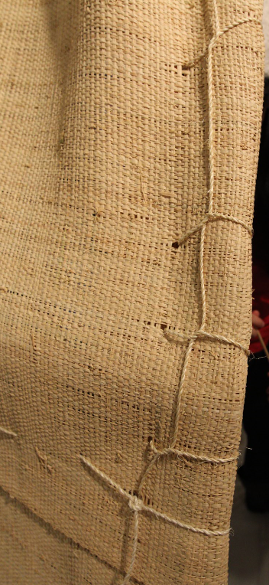
Walls
Made out of raffia mats
Provides ventilation and shade
Permanently bound to frame
-image- close up of raffia
Notes:
The raffia mat that makes up the walls is a locally available material. The weave on the fibers has tiny openings that made this a very promising solution for the first part of the skin. These openings are small enough that privacy isn’t an issue, yet they are large enough that they greatly improve the ventilation within the shelter and create plenty of space for sisal rope to go through in order to bind sheets together or connect it onto the frame. This material covers the entire structure and has a curtain that can be fixed in an open or closed position for the entrance.

Slide 24
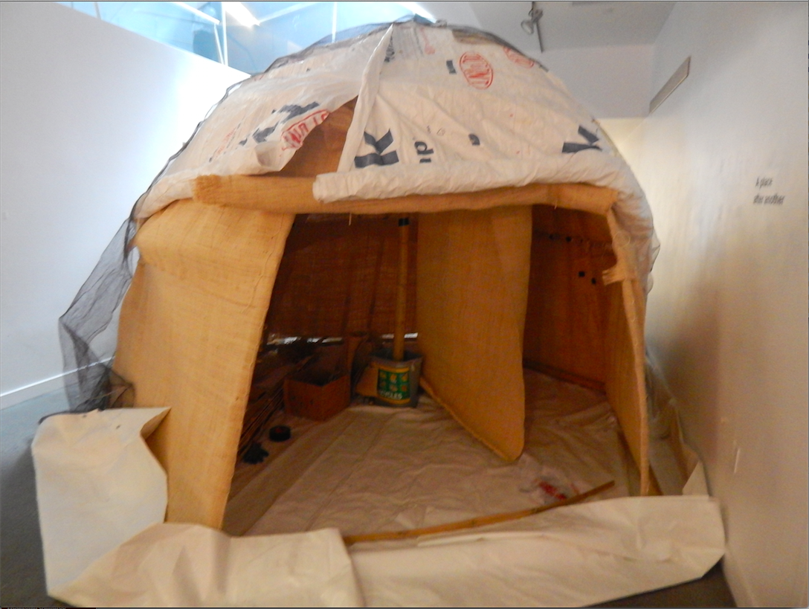
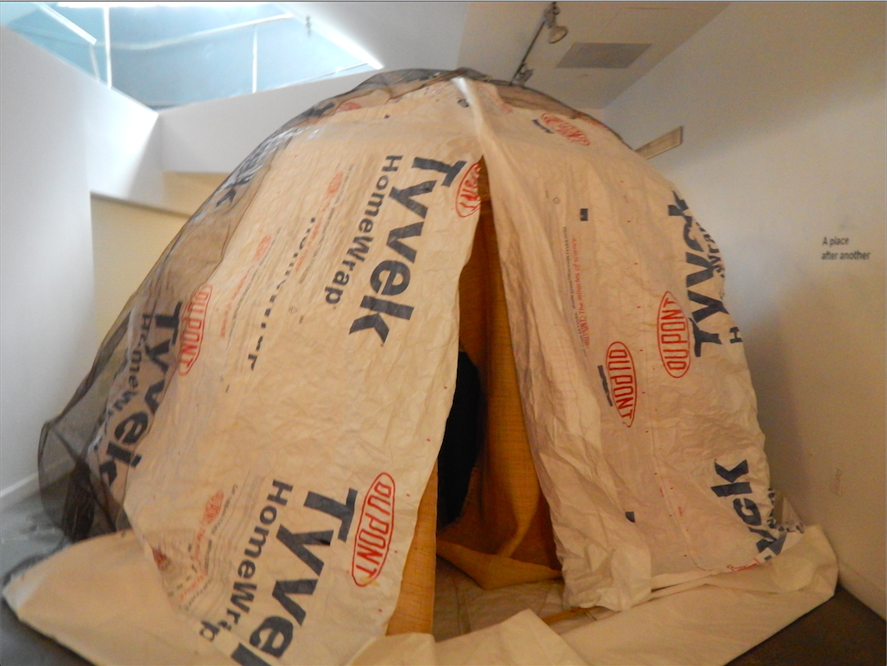
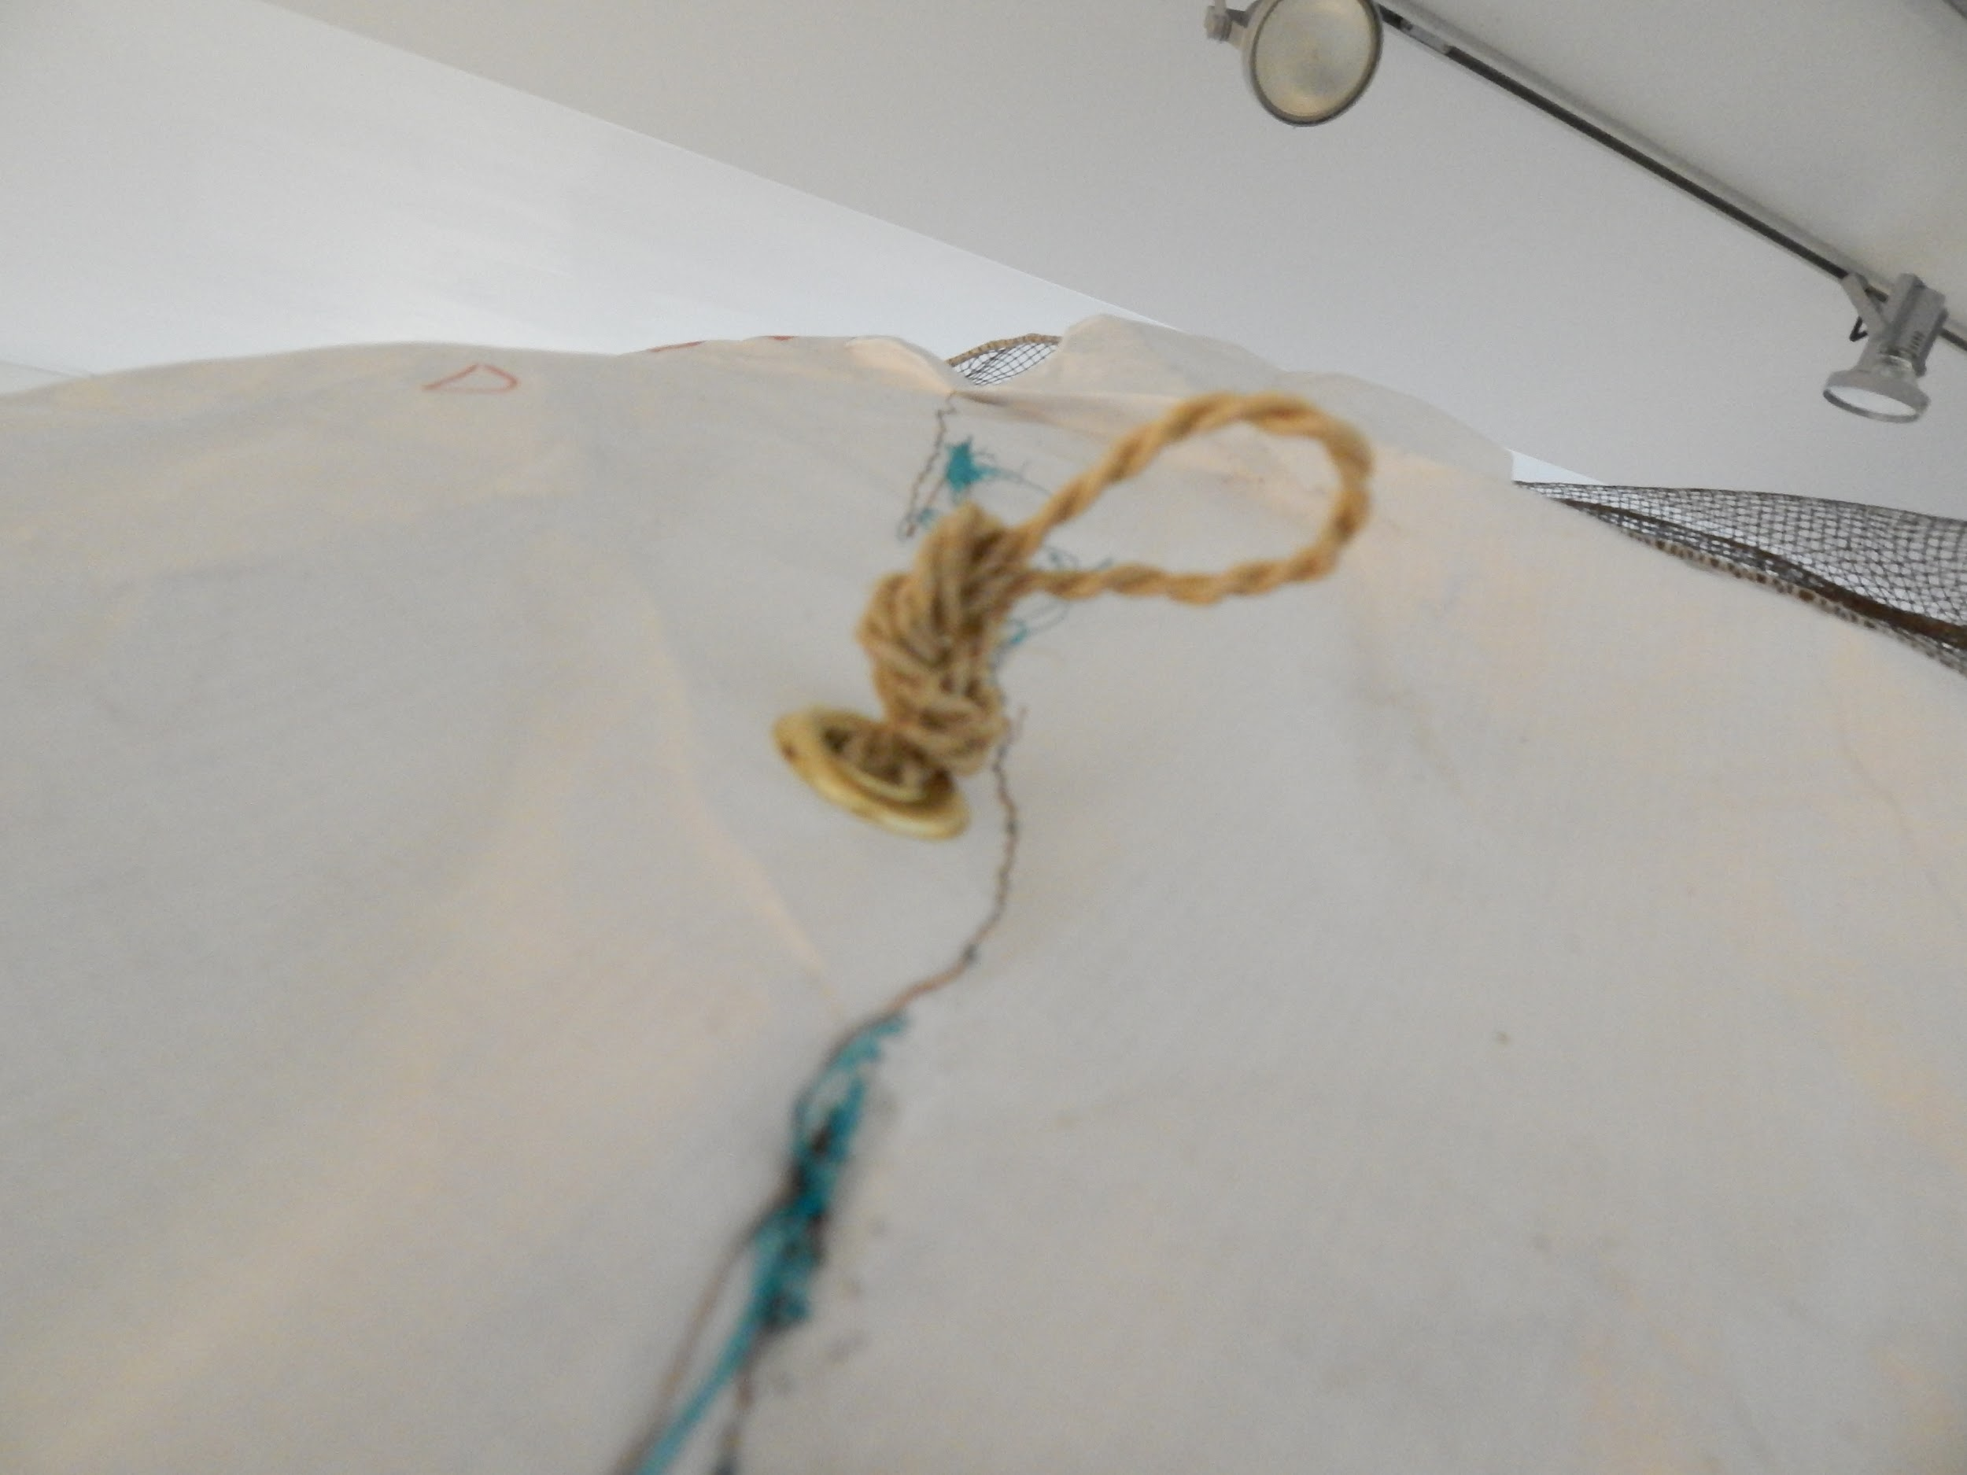
Raincoat
Storable Tyvek covering
Waterproof, lightweight, highly tear-resistant
Secured to frame through grommets
Rolled up Tyvek mode
Zoom in to show grommets
Notes:
The next layer is composed of Tyvek. Tyvek is a synthetic material that is very durable and waterproof. These qualities make it a very efficient solution for protecting the shelter against natural elements. The raincoat is constructed to cover the entire shelter with a curved layer of Tyvek and it’s tied down with openings made in the skin with _____ knots and sisal rope. one of the design features of the raincoat is its ability to be stored away when it isn’t needed. It rolls up above the entrance and hooks onto the knots that are binding down the Tyvek.

Slide 25
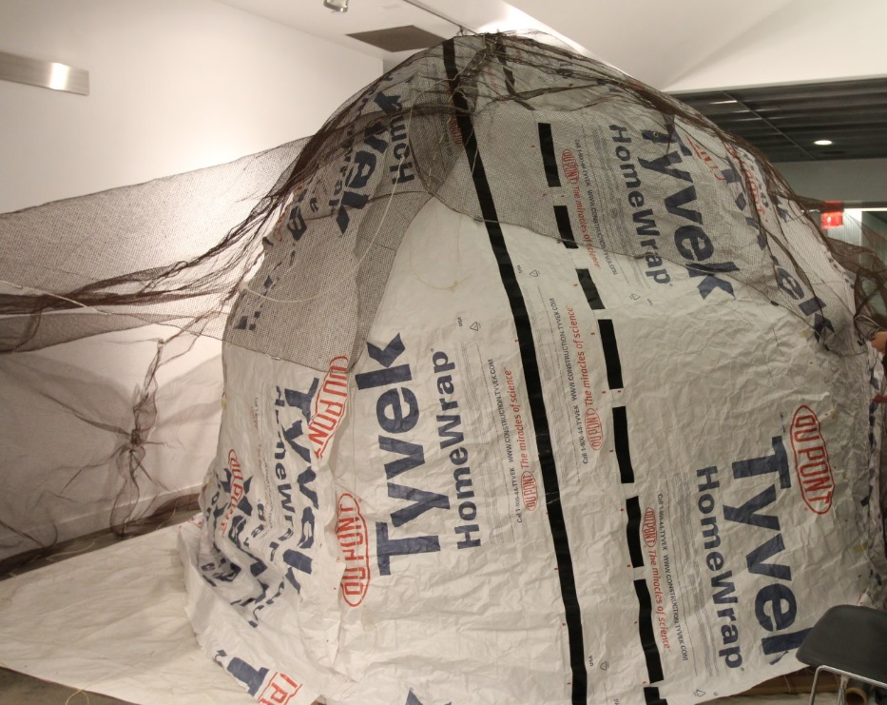
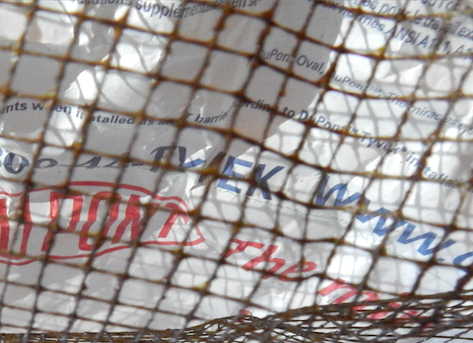
Netting
Made of minnow seine
Absorbs force of rainfall
Secured with rebar
Overall picture of the set up netting
close up of netting
Notes:
Finally, the outermost layer is made of polyester fishing netting. This layer will alleviate some of the rainfall and wind. The netting is stretched over the entire shelter and held to the ground with locally sources rebar stakes.

Slide 26
Shelter Kit
Notes:
The purpose of the skin and floor is to create a barrier between the interior of the shelter and the surrounding environment. Overall, the skin has to satisfy specific criteria in order to be effective. It must be waterproof and comfortable to live in. The skin of the shelter is broken down into three different layers; each one provides a different benefit to the shelter and work together to meet all of our design goals.

Slide 27
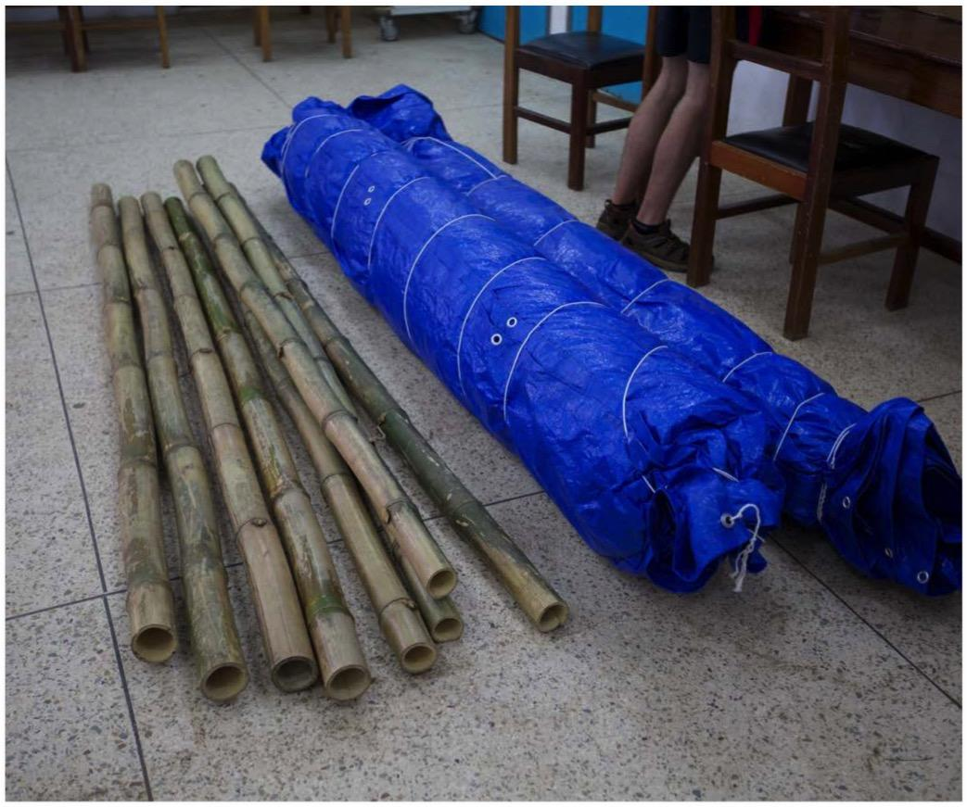
What we started with..

Slide 28
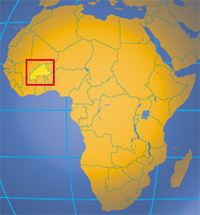
Where can we deploy RAMESSES?
Burkina Faso
Familiar with location
Poor conditions of living
Proximity to countries with resources
Notes:
Kareem: With this kit in place, we can bring this shelter to a practical location in Sub-Saharan Africa-- for example Burkina Faso. We are already familiar with this location because RAMESSES I was implemented in Djibo before (northern Burkina Faso), and we learned from the experimental outcomes. However, current political uprisings seem to hinder us from directly implementing to the refugee camps.
In order to bring this shelter to the camps, we plan to bring bamboo and raffia from nearby countries, like Nigeria. Among several candidates, Nigeria has the most abundant bamboo with only 1,500 km away from Burkina Faso. For raffia, there are many skilled locals who can weave raffia into mats, easily found nearby, and the Dupont company can supply with enough Tyvek for our shelter locally. It is assumed that there are not many markets available for us to utilize; however, we plan to set our own market in order to supply ourselves resources and help build the economy of the country through this.
http://www2.dupont.com/South_Africa_Country_Site/en_ZA/About%20DuPont/DuPont%20Sub-Saharan%20Africa.pdf

Slide 29
What’s Next?
Notes:
The purpose of the skin and floor is to create a barrier between the interior of the shelter and the surrounding environment. Overall, the skin has to satisfy specific criteria in order to be effective. It must be waterproof and comfortable to live in. The skin of the shelter is broken down into three different layers; each one provides a different benefit to the shelter and work together to meet all of our design goals.
-Test shelter under real climate and conditions
-Identify shortcomings
-Bring shelter to refugee camps

Slide 30
